Slide 1
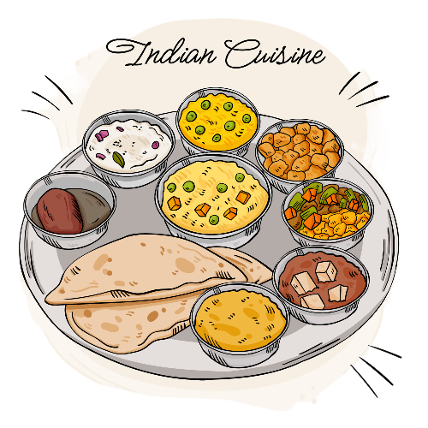
Ahaar
Know Your Plate, Shape Your Health

Slide 2
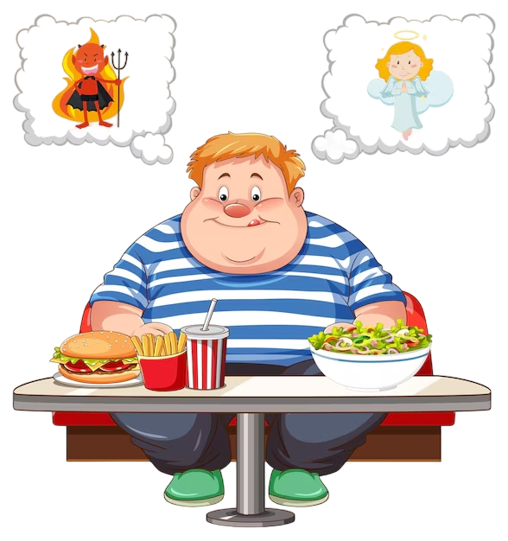
What’s The Problem ?
In India, lifestyle diseases like diabetes, obesity, and heart disease are becoming increasingly common. Around 8-10% of Indians suffer from diabetes, and 40% are overweight. These numbers aren’t just statistics—they represent people in our communities. Ahaar is here to help individuals take control of their health by understanding the nutritional content of their meals.
Ahaar is an easy-to-use app that allows users to take a photo of their meal and instantly get detailed information about its nutritional value—proteins, carbs, fats, vitamins, and more.
It’s not just about counting calories; it’s about empowering users to make
healthier food choices every day.

Slide 3
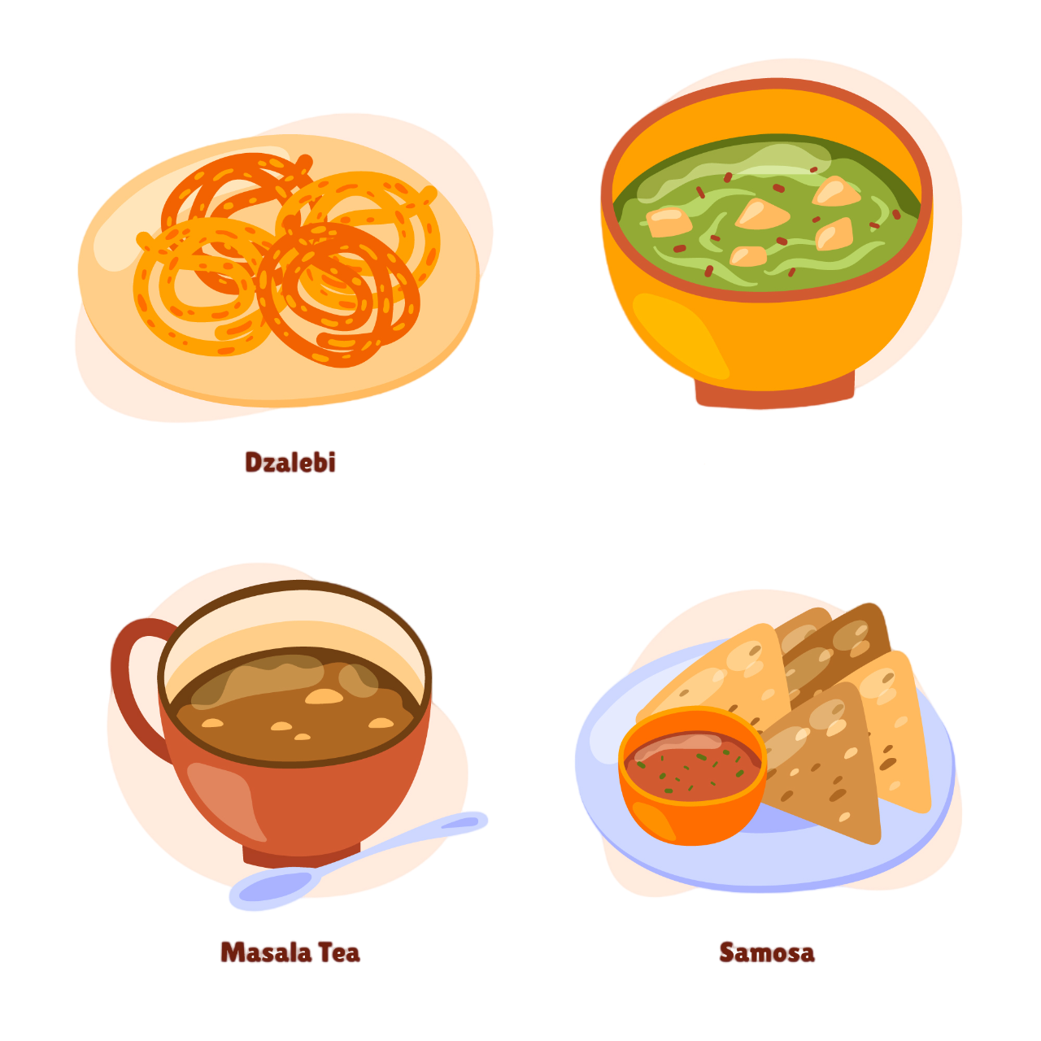
What is Ahaar ?
Ahaar is an intelligent Android application designed to enhance nutrition tracking by detecting foods in real-time, analyzing nutritional values, and helping users maintain a balanced diet. Powered by machine learning, Ahaar identifies food items on a plate, tracks nutritional intake (calories, fats, proteins, etc.) daily, weekly, and monthly, and provides personalized diet recommendations to meet individual health goals.

Slide 4



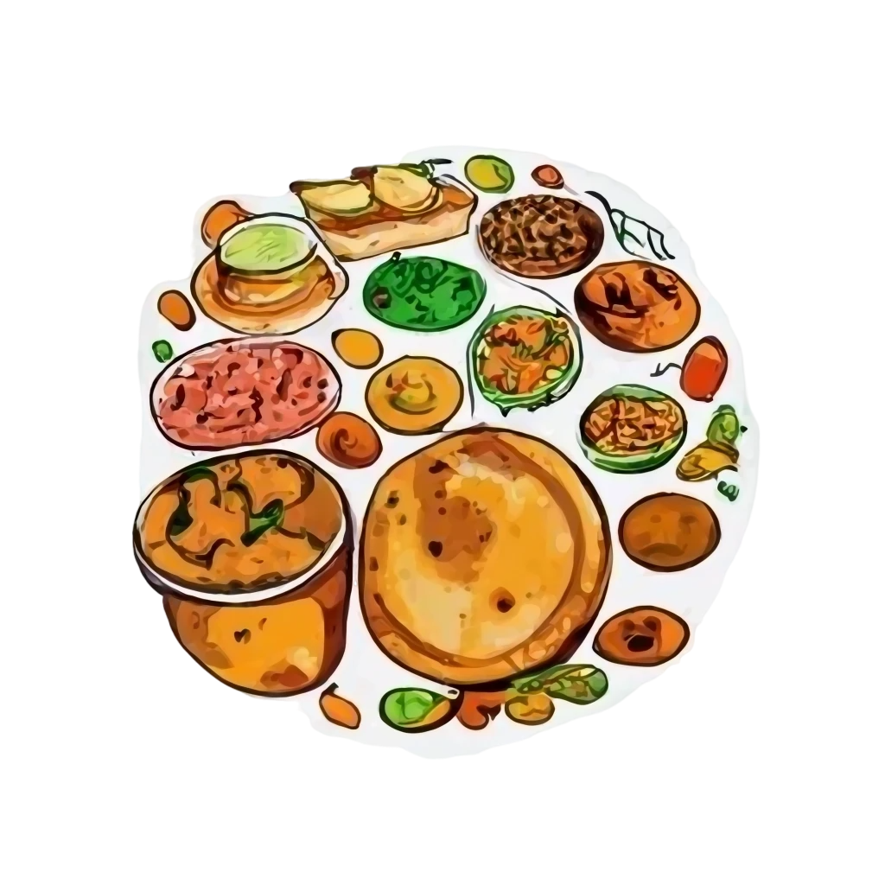
Why Ahaar ?
Rising Health Issues With increasing cases of diabetes, heart disease, and obesity, tracking nutrition is more important than ever. *Ahaar* helps users monitor their food intake and take preventive steps to reduce health risks.
Awareness About Indian Foods Many Indians eat traditional foods like roti, dal, and samosas without knowing their nutritional value. *Ahaar* helps users understand the impact of these foods on their health, guiding them to make better choices.
Filling the Knowledge Gap in India, most people lack detailed knowledge of nutrition. Ahaar bridges that gap by providing instant nutritional data for a wide range of Indian foods, helping users make informed dietary decisions.
Saves Time Ahaar simplifies the process of meal tracking, providing immediate nutritional breakdowns, saving users time and effort in managing their diet.

Slide 5
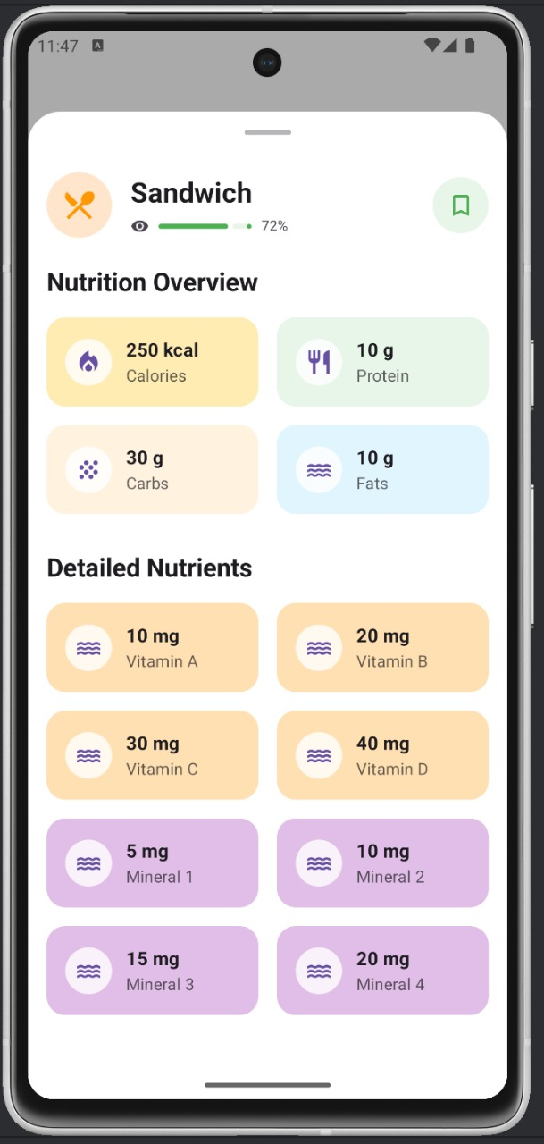
Project Flow Chart
APP User-Interface
Model
Trained Model
API Fetch
Database
Training
Machine Learning
APP

Slide 6



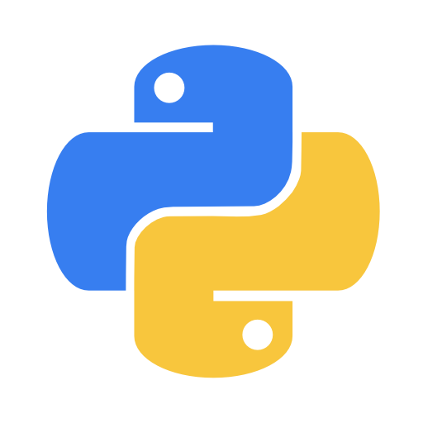

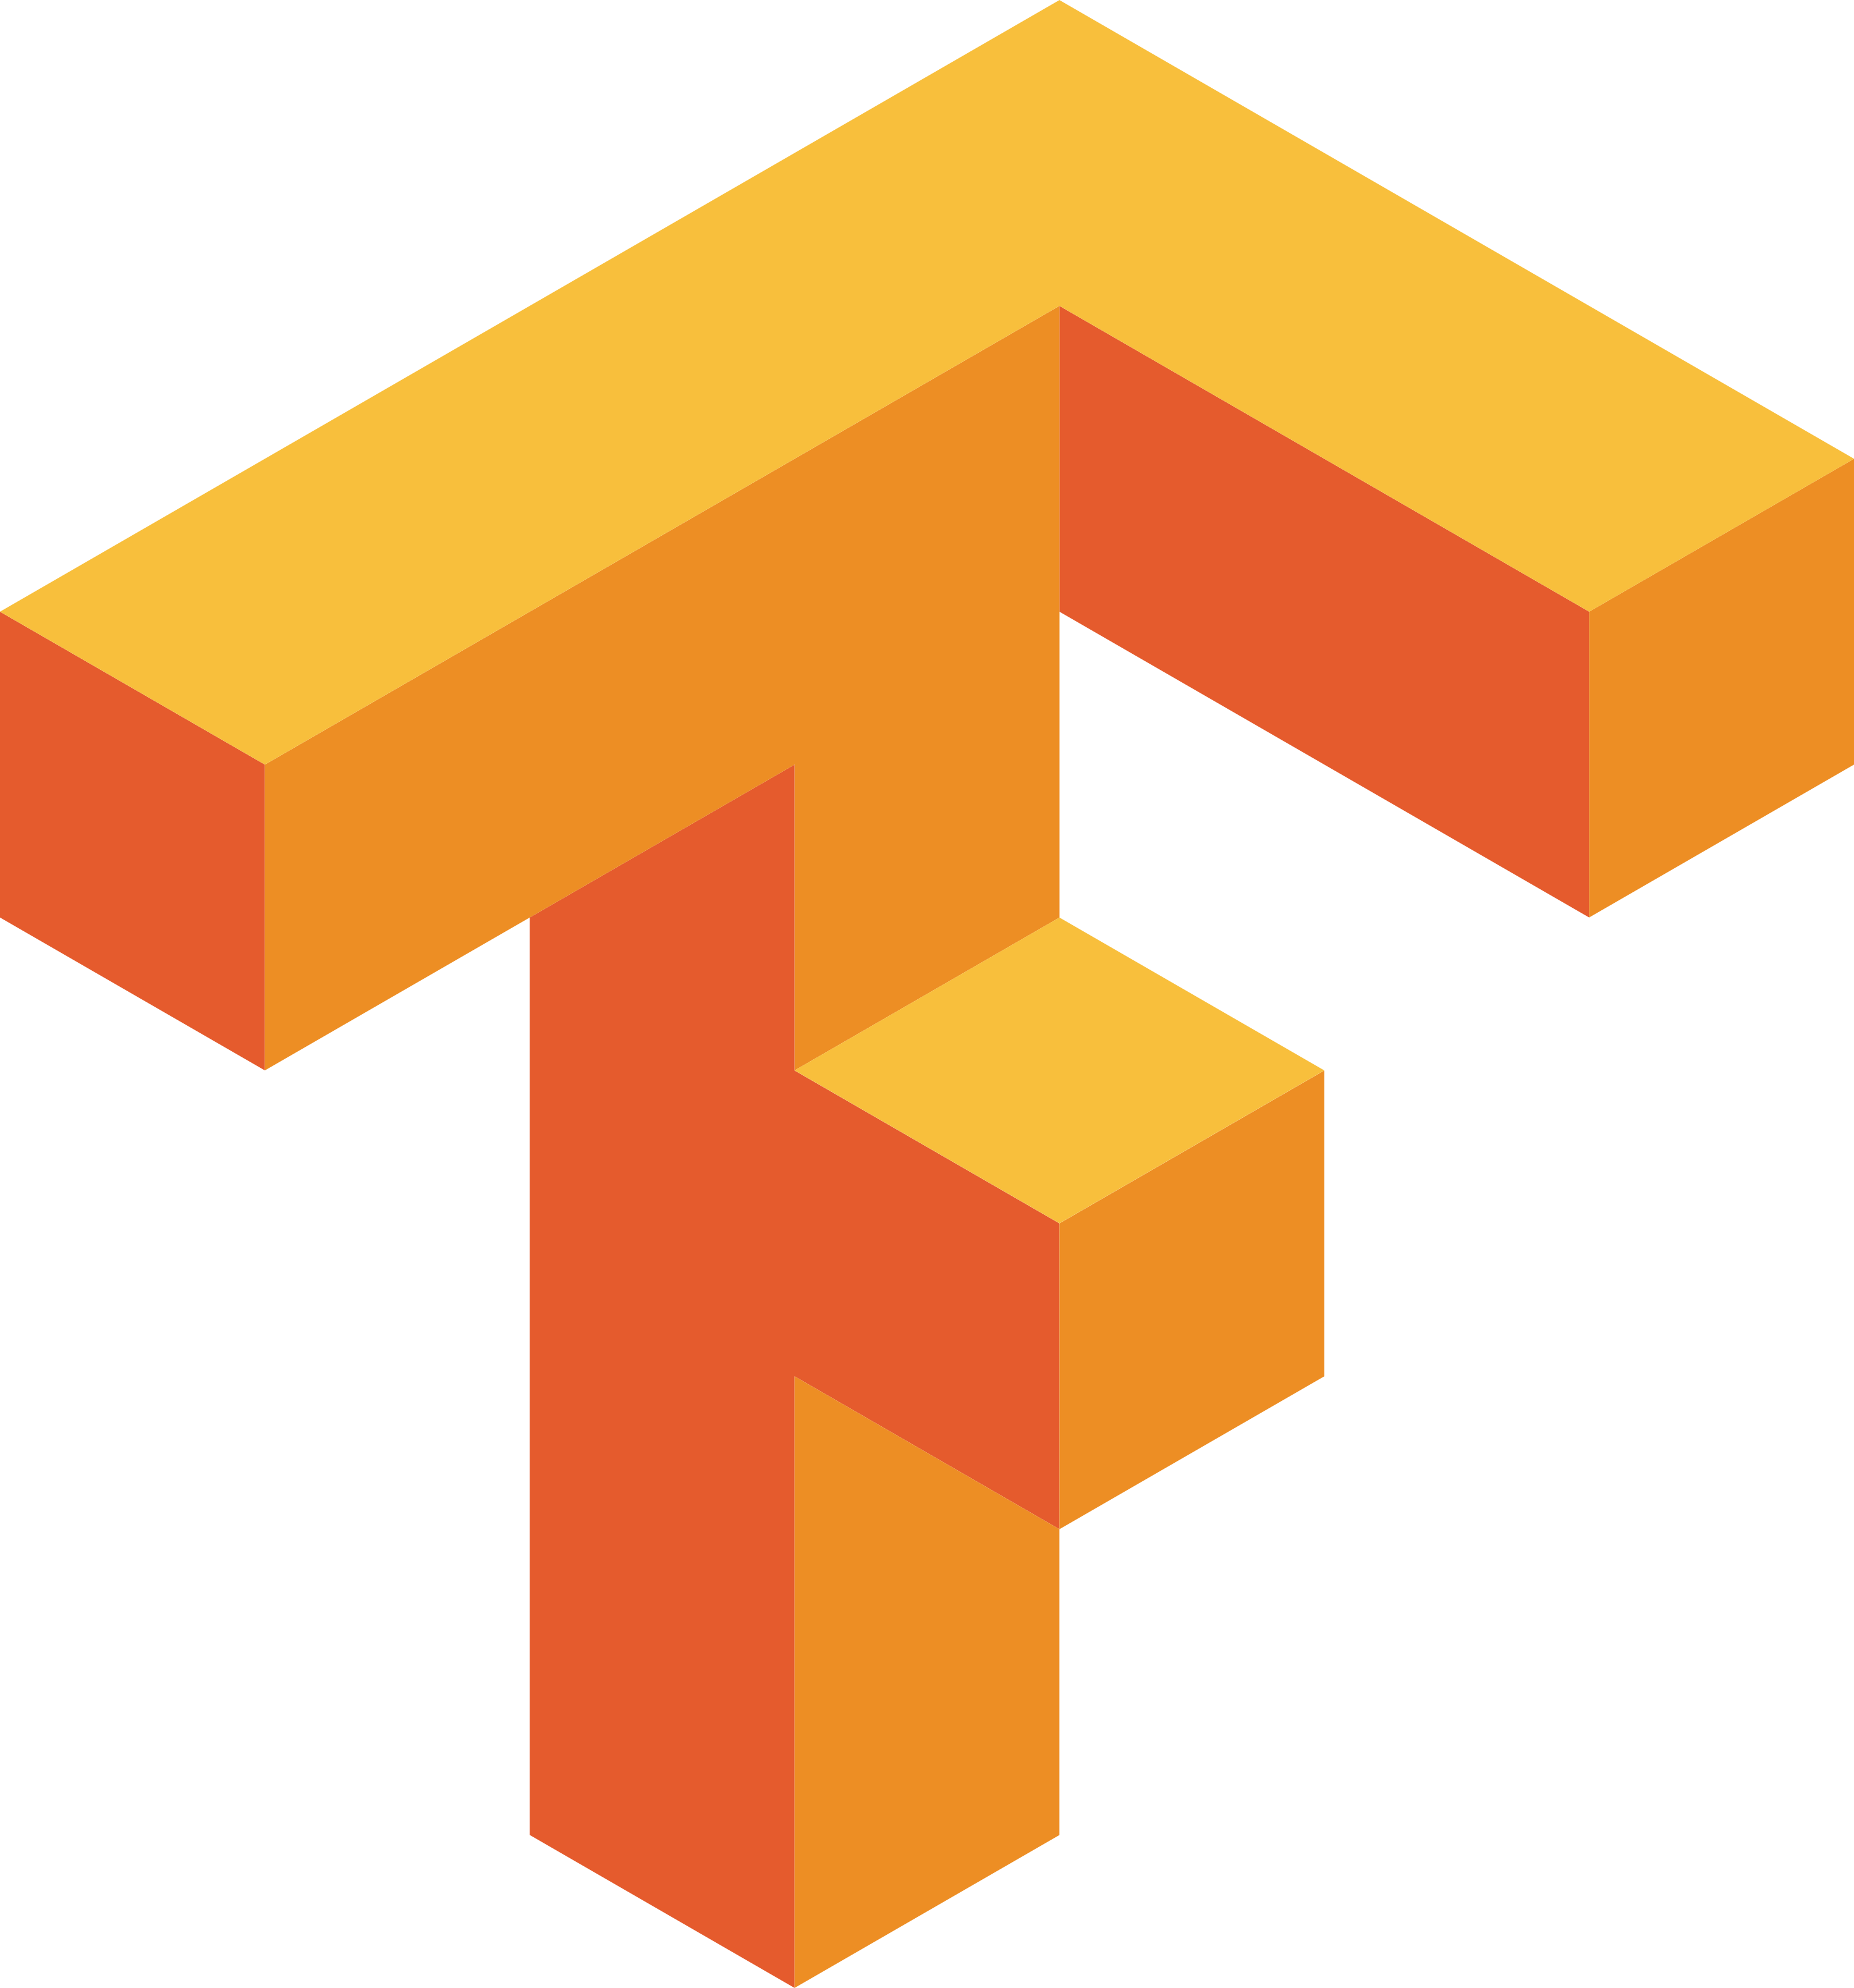


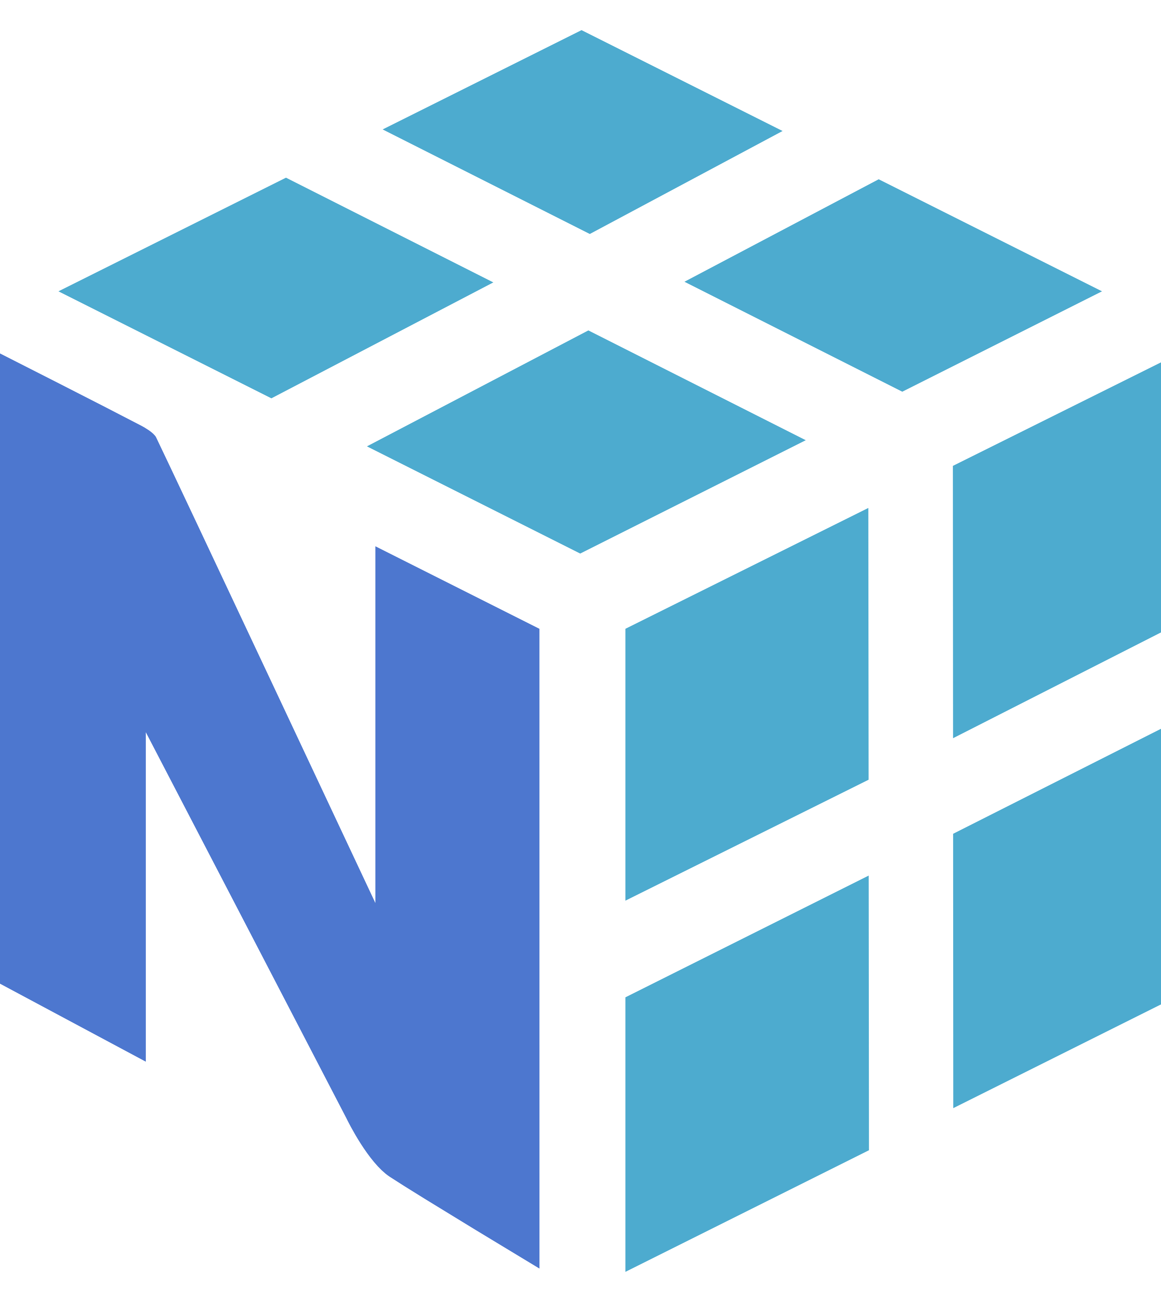
Used Tech Stacks
Android: Core application framework.
Kotlin: Primary programming language for Android development.
Machine Learning: Custom-trained model for food detection and nutritional estimation.
TensorFlow Lite: Efficient inference on mobile devices.
Python: Used for data preprocessing and training machine learning models.
Pandas: Data manipulation and analysis.
NumPy: Numerical operations and data handling.
TensorFlow and Keras: Deep learning frameworks for building and training models.
Gemini 1.5 flash Model: Advanced model used for precise food recognition.
Streamlit: Interface for testing and visualizing model outputs.
Firebase: Backend for data storage, user authentication, and analytics.
Retrofit: Library for managing network requests in Android.
Seaborn and Matplotlib: Visualization libraries for data exploration and analysis.

Slide 7



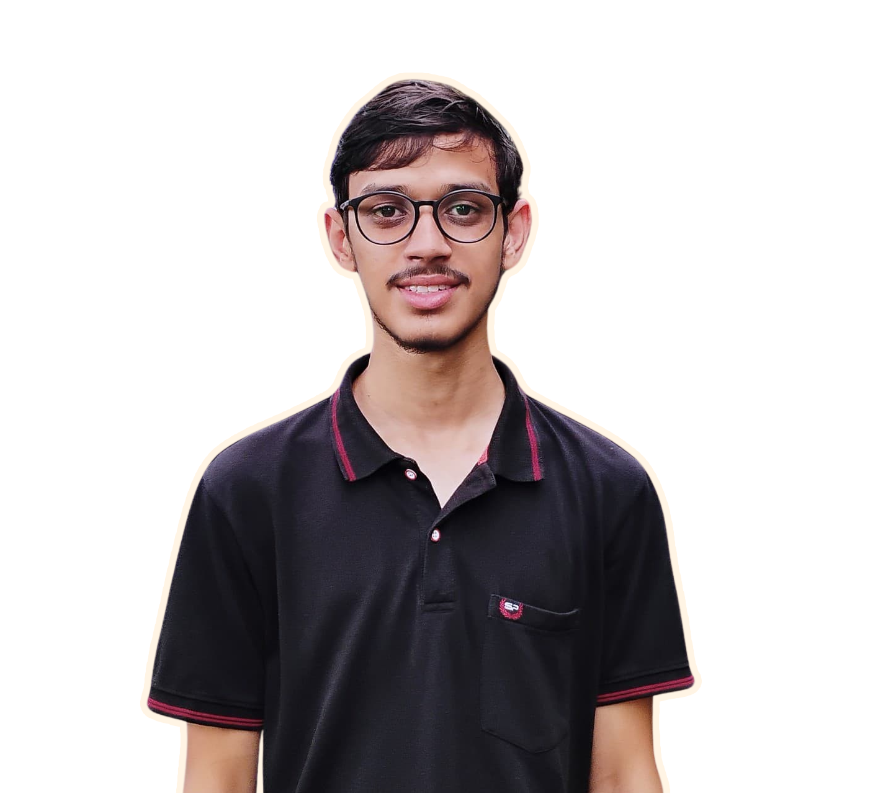
Team Sapiens
Satyam Kumar
Avinash Sharma
Aryan Jaiswal
Prince Yadav

Slide 8
Thanks

